Slide 1

Capstone Project

Slide 2



Personal BACKGROUND
Name : VARSHITHA NALABOTHU
Past Experience : Fresher
Qualification : B-TECH CSE
Career Summary : A highly motivated and quick-learning fresher with training knowledge in backend development. Proficient in Java, Spring Boot, REST API, and MySQL with hands-on experience in building and testing scalable applications. Completed a hands-on capstone project in microservices architecture, showcasing expertise in REST API development and database management. Developed strong analytical and communication abilities during training.
www.collaberadigital.com

Slide 3


Key Takeaways/Learnings from the Program (HTD)
Technical Skill Development
Project Implementation of real-world projects
Collaboration and Communication
Agile Methodology
Problem-Solving and Debugging
Professional Growth Mindset

Slide 4

Problem Statement of the Capstone Project-Air Transport System
Develop a real-world project for administrators to manage airport details, plane information, and passenger bookings. The system involves creating microservices using Spring Boot.
Microservice Applications need to include:
Login Application
Admin Application
Plane Application
Airport Application
Booking Application
The primary features include login authentication, CRUD operations for managing airports, planes, and bookings, and search functionalities. Implement this using Postman.

Slide 5
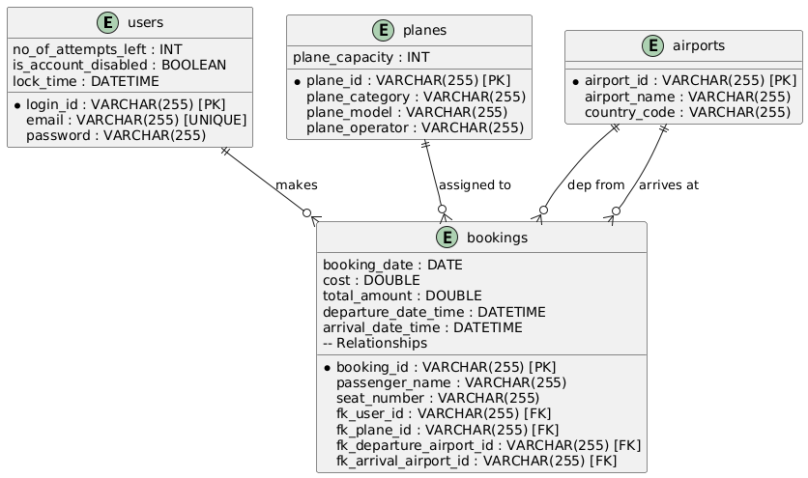
ENTITY-RELATIONSHIP DIAGRAM

Slide 6
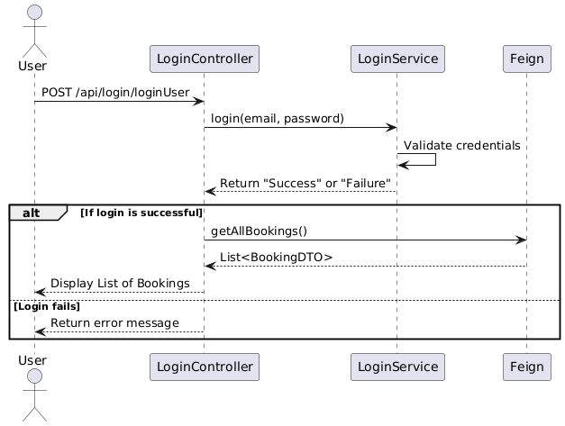
SEQUENCE DIAGRAM

Slide 7
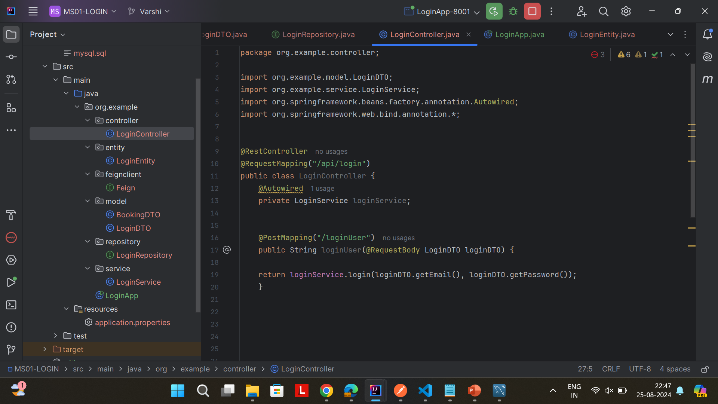
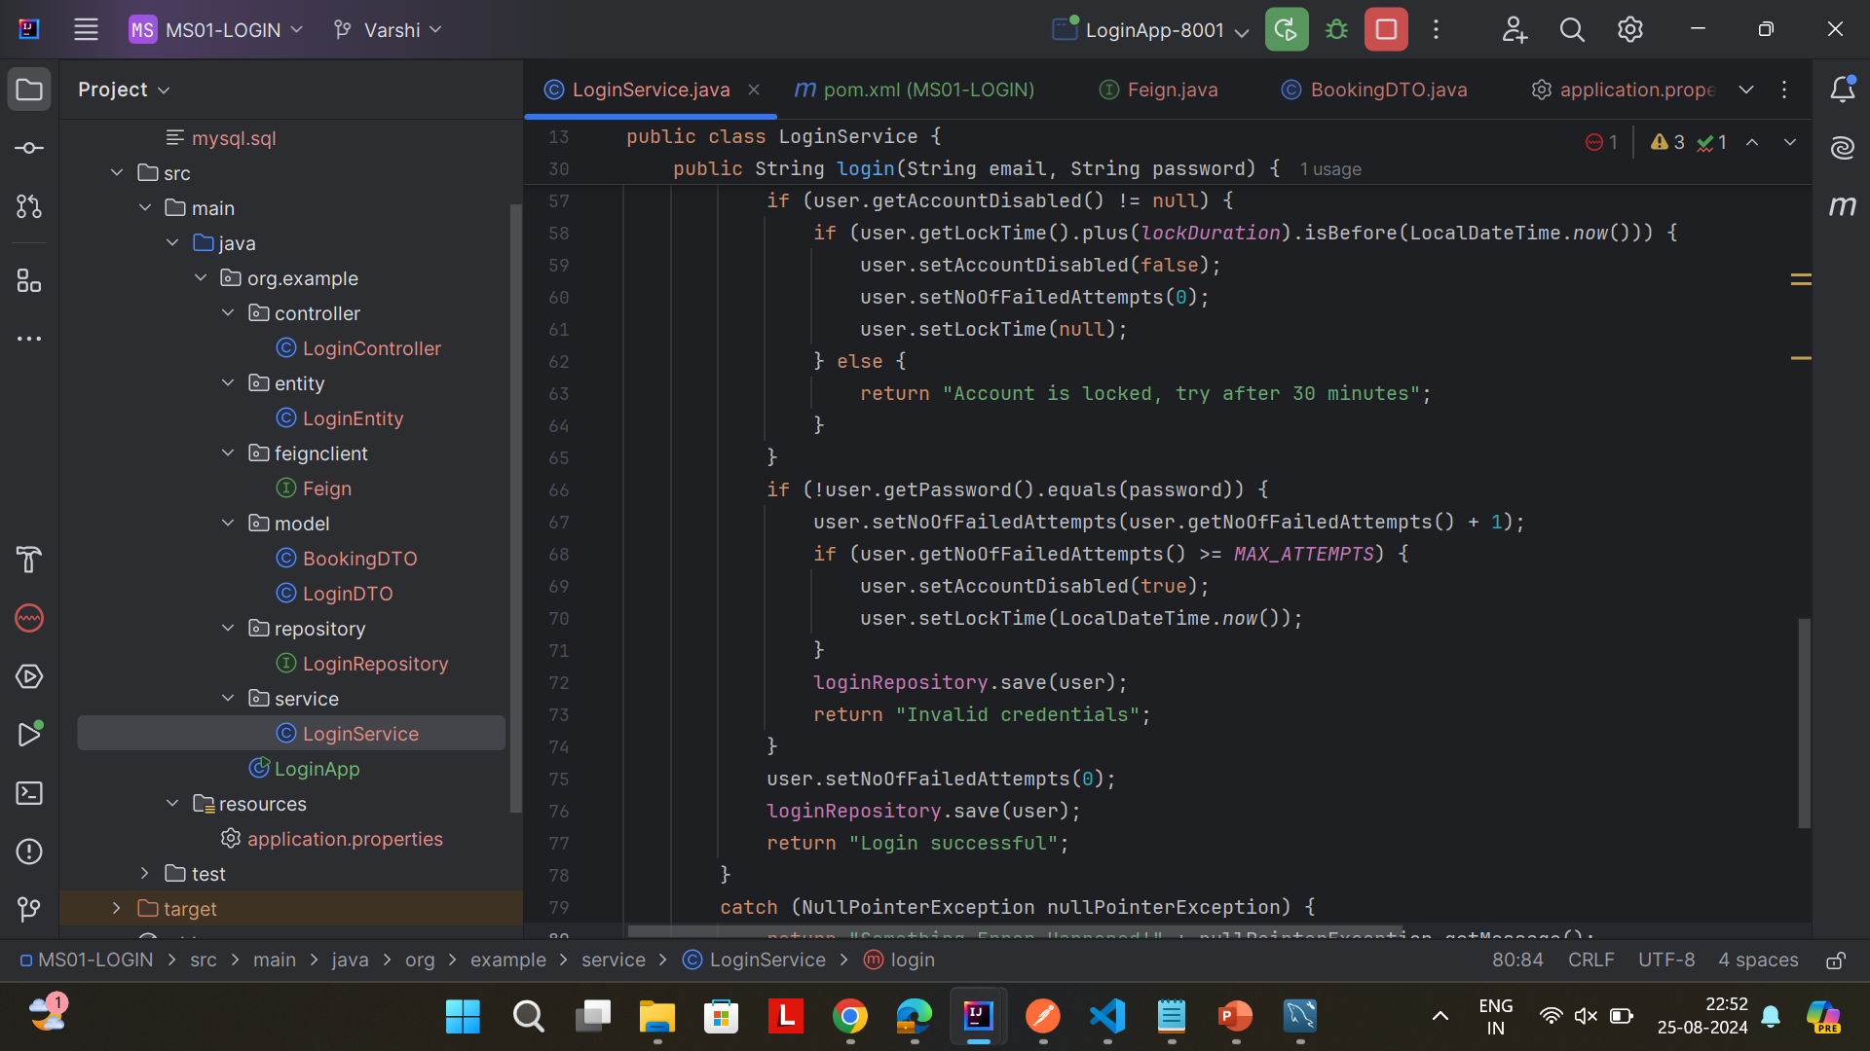
Important areas of the Project with screenshots
LOGIN MICROSERVICES

Slide 8
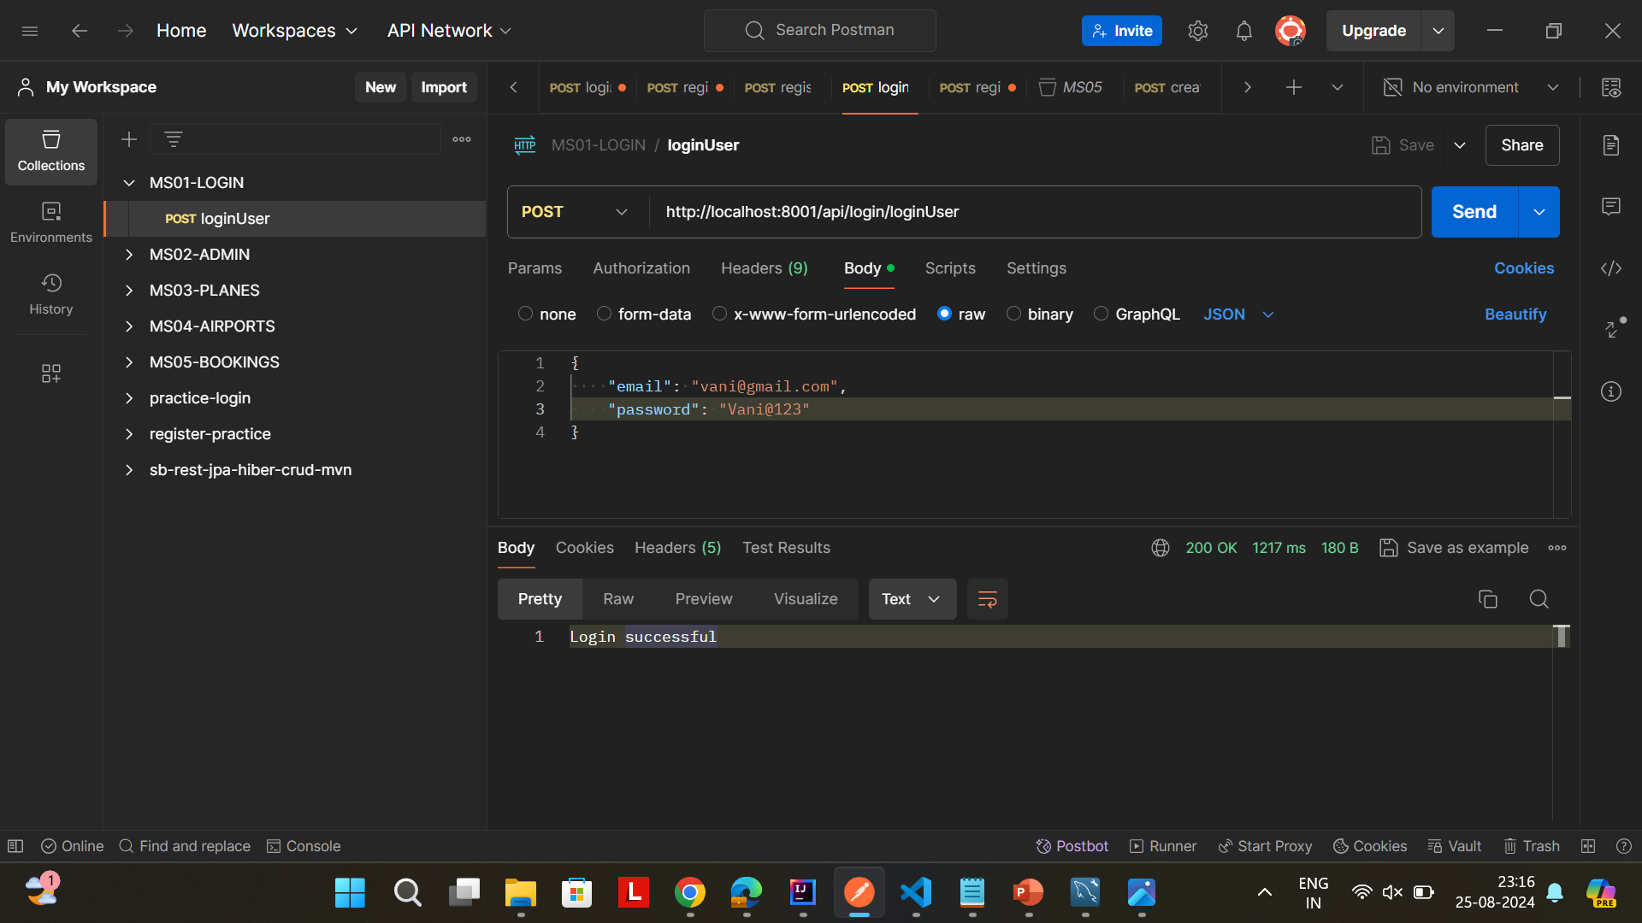
Important areas of the Project with screenshots
LOGIN MICROSERVICES

Slide 9
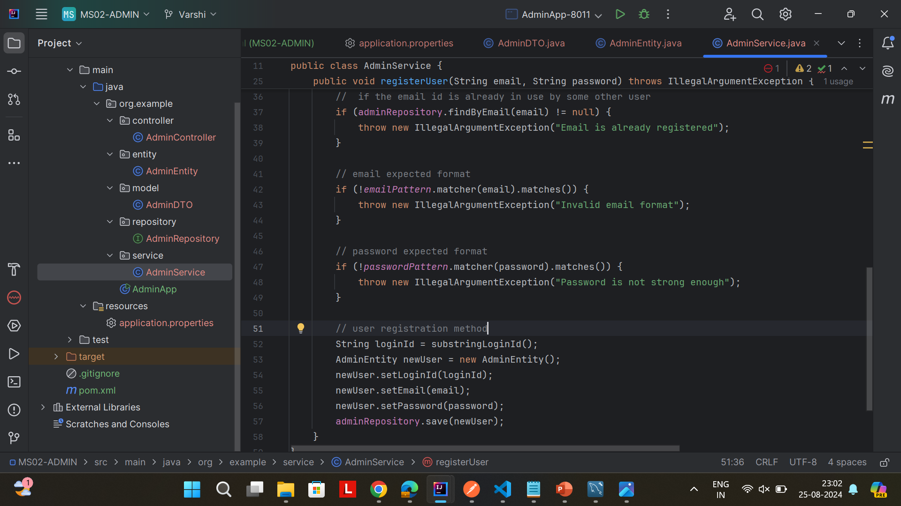
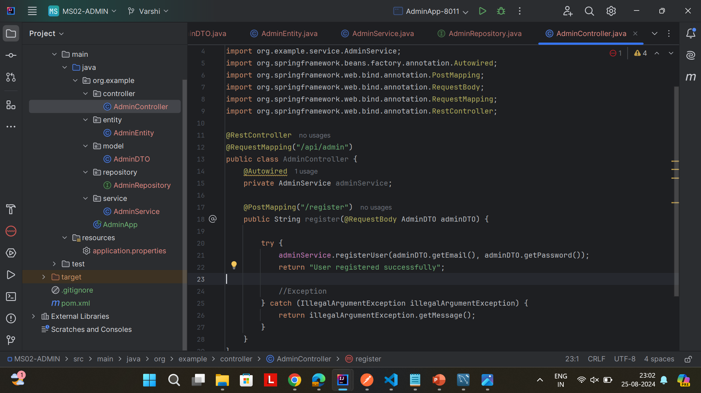
Important areas of the Project with screenshots
ADMIN MICROSERVICES

Slide 10
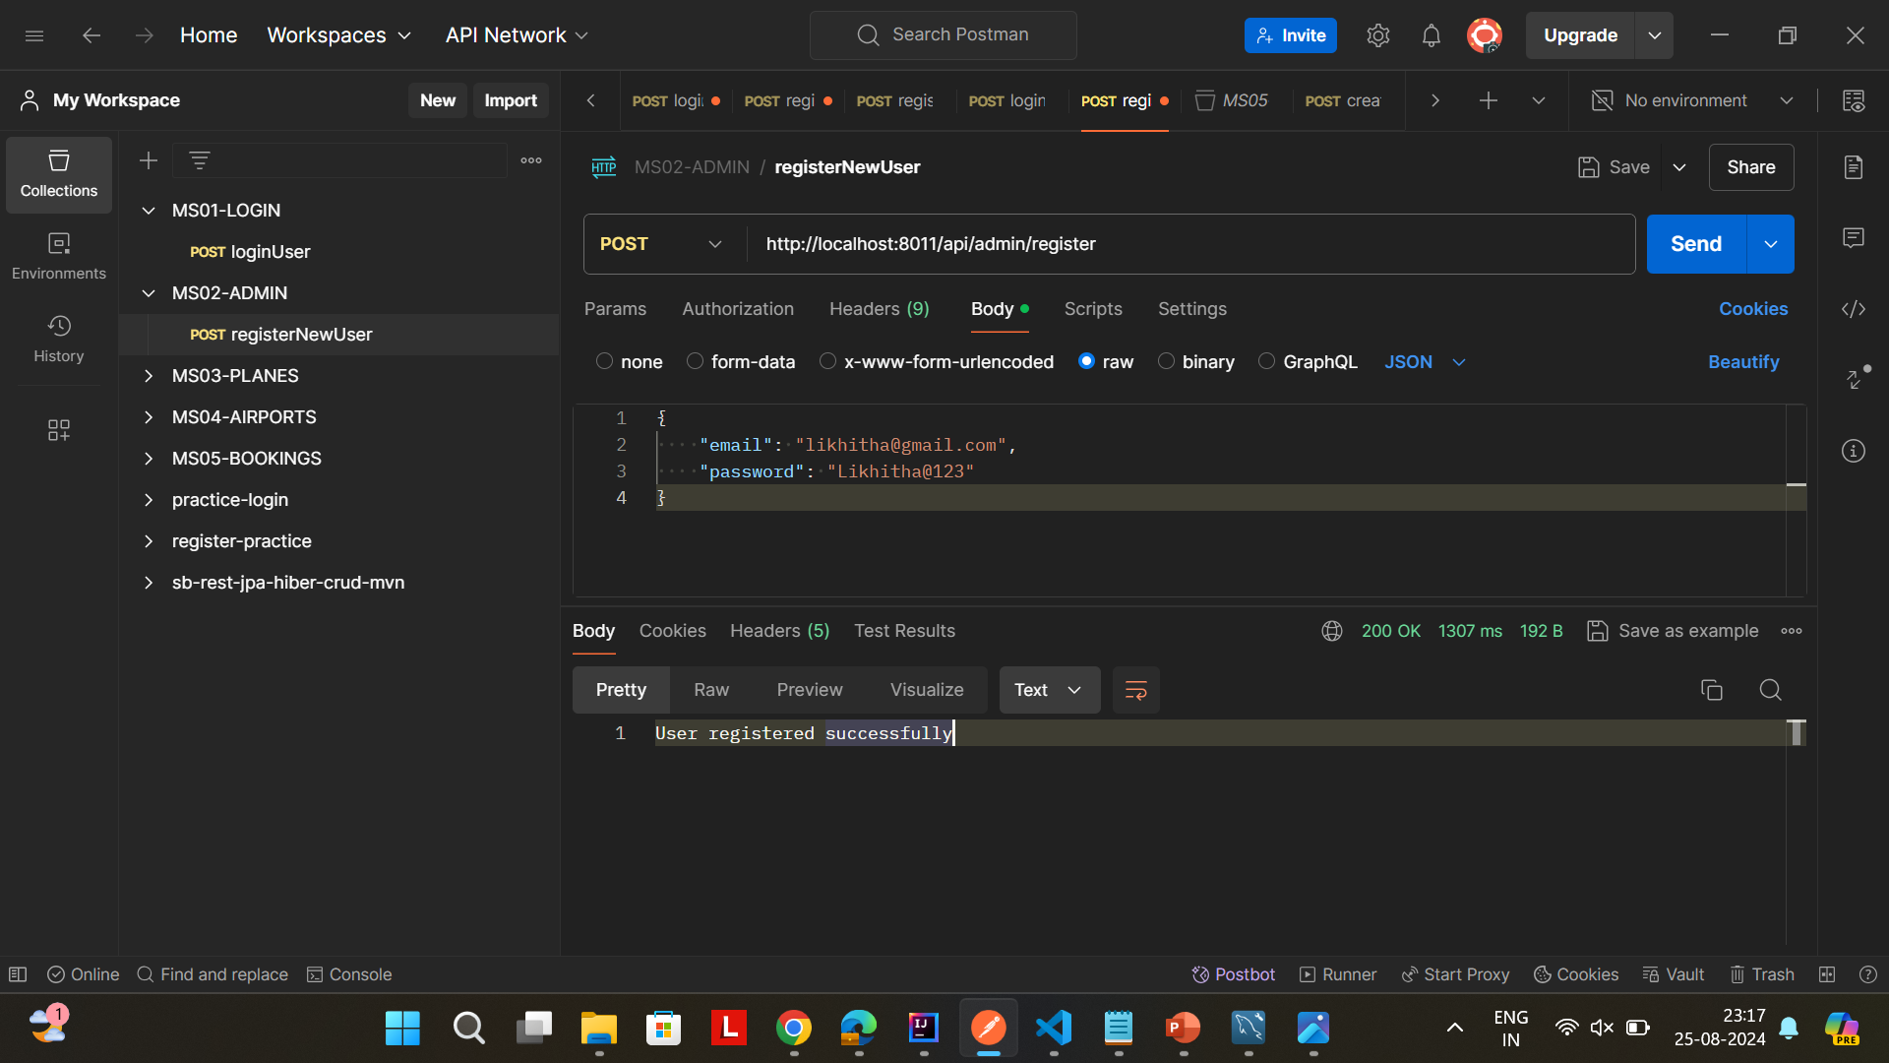
Important areas of the Project with screenshots
ADMIN MICROSERVICES

Slide 11
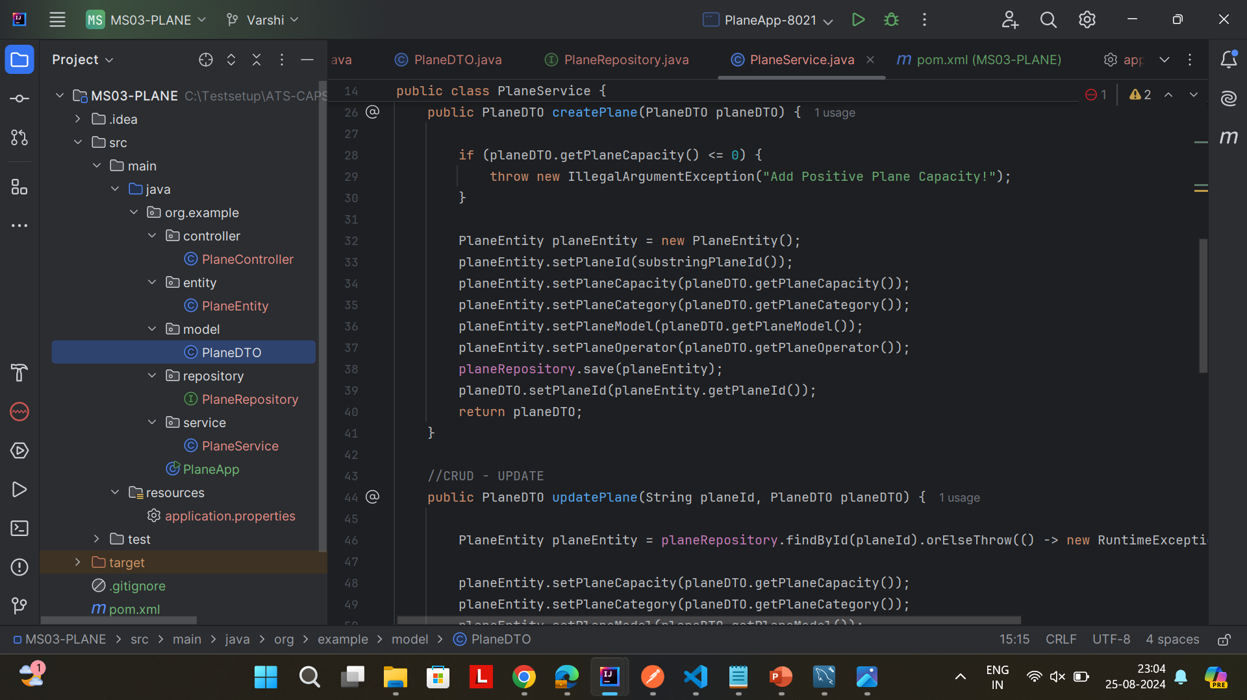
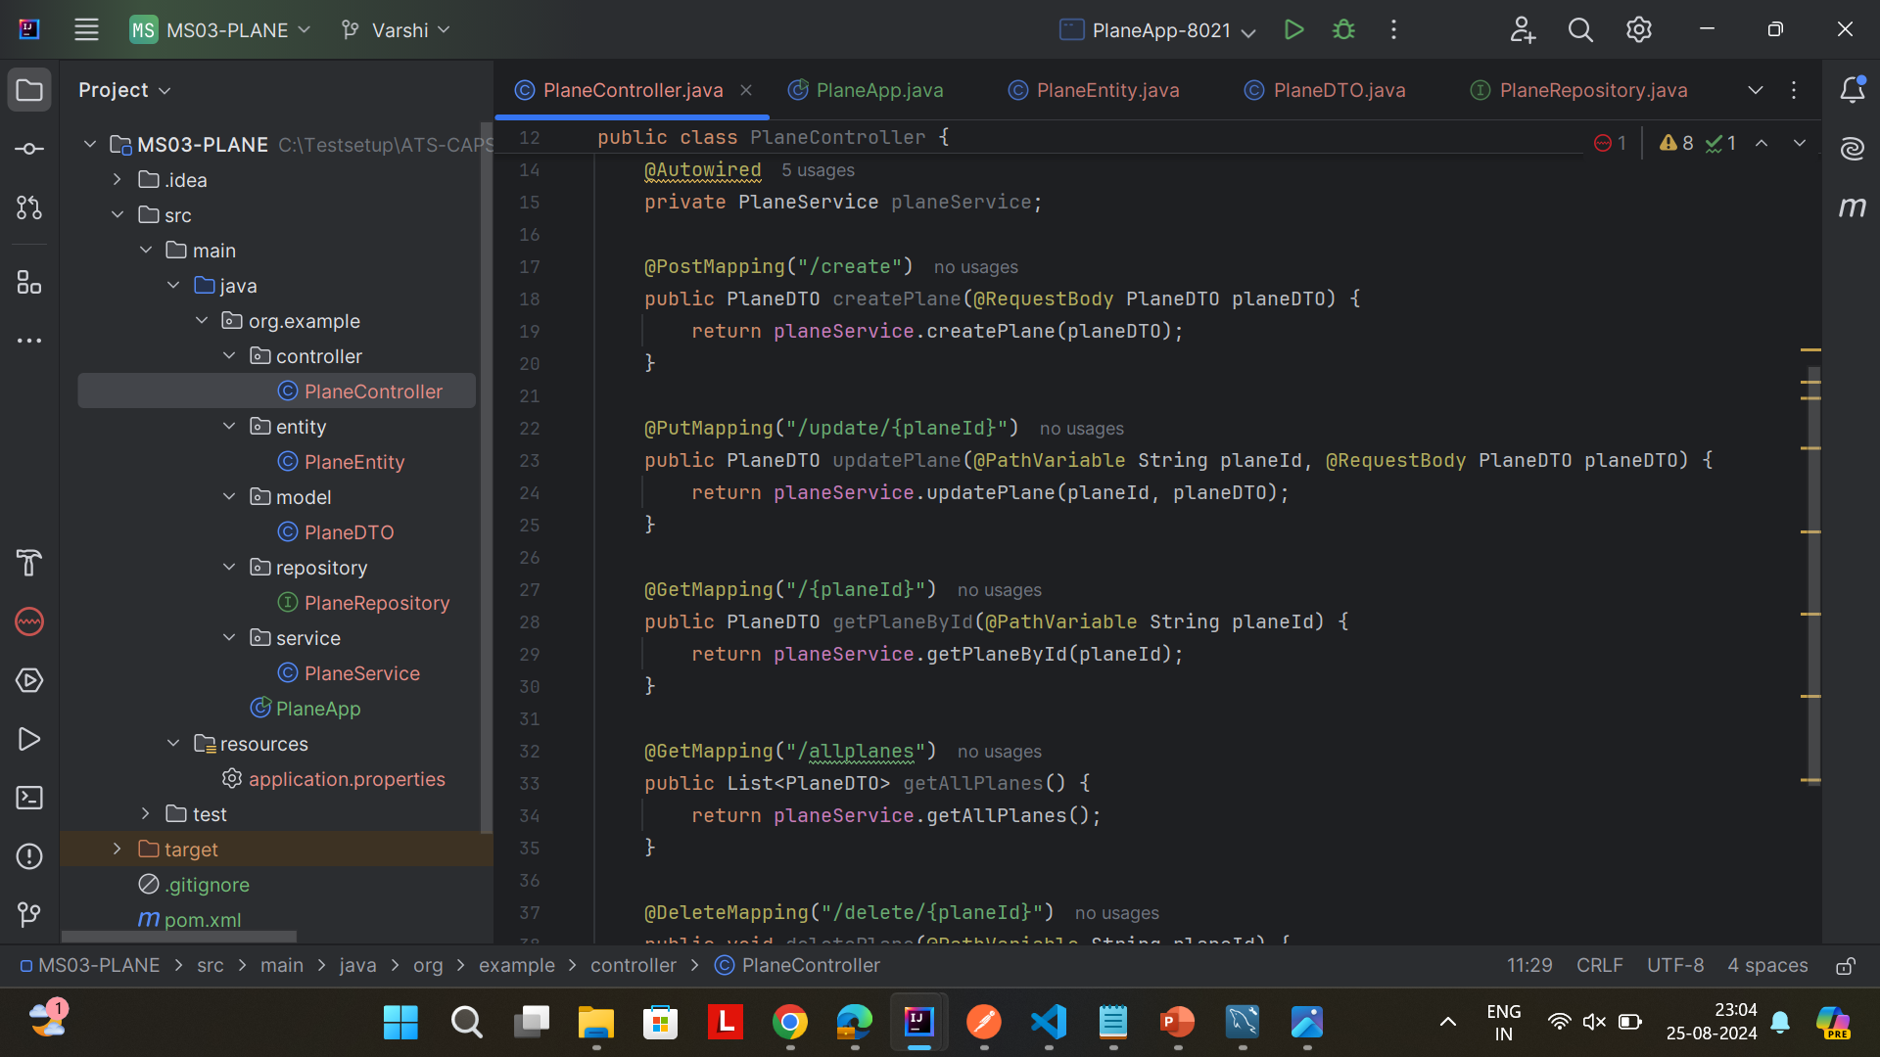
Important areas of the Project with screenshots
PLANE MICROSERVICES

Slide 12
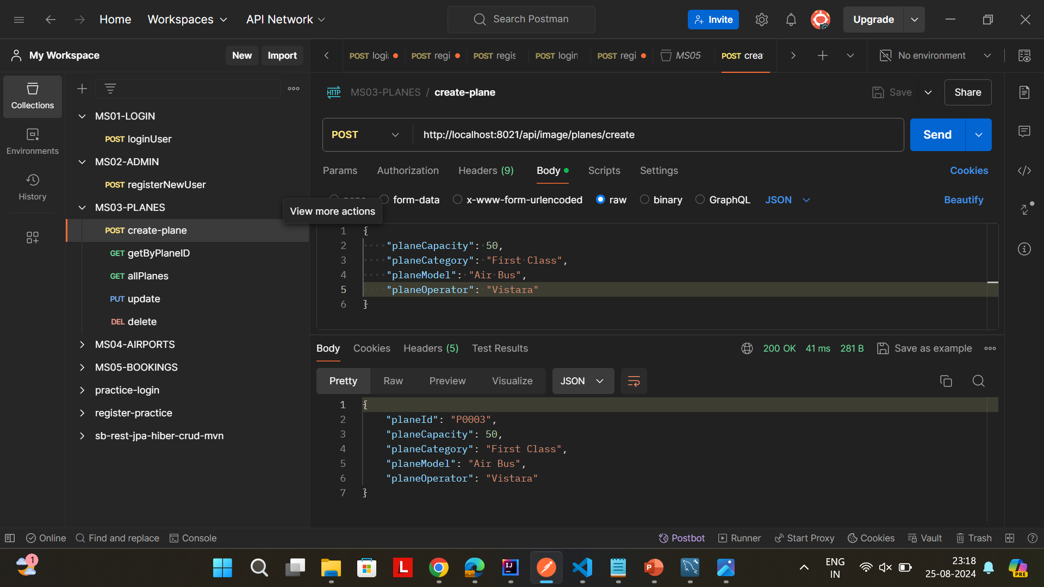
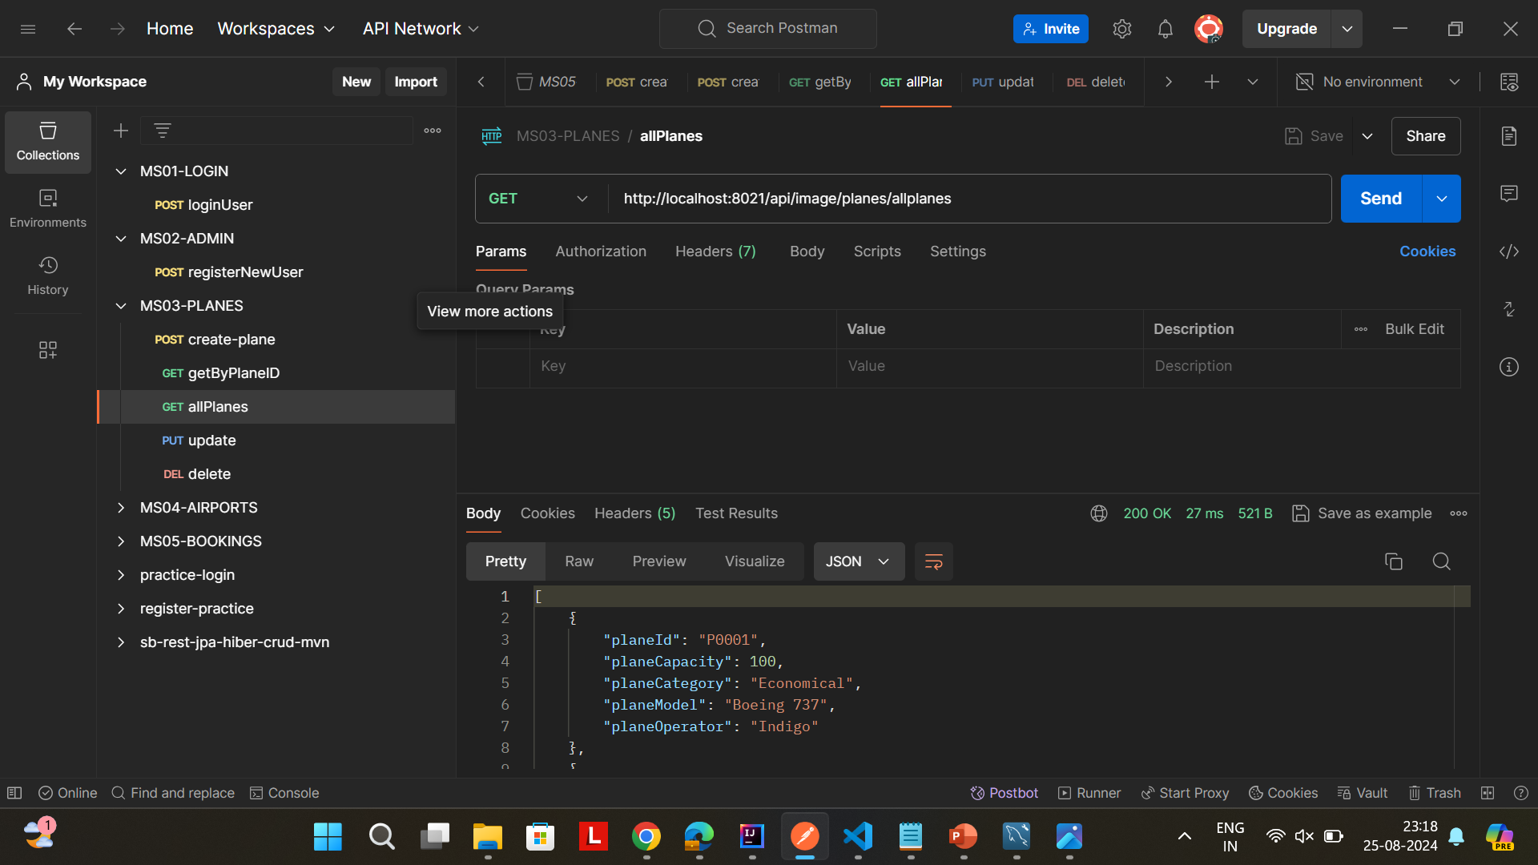
Important areas of the Project with screenshots
PLANE MICROSERVICES

Slide 13
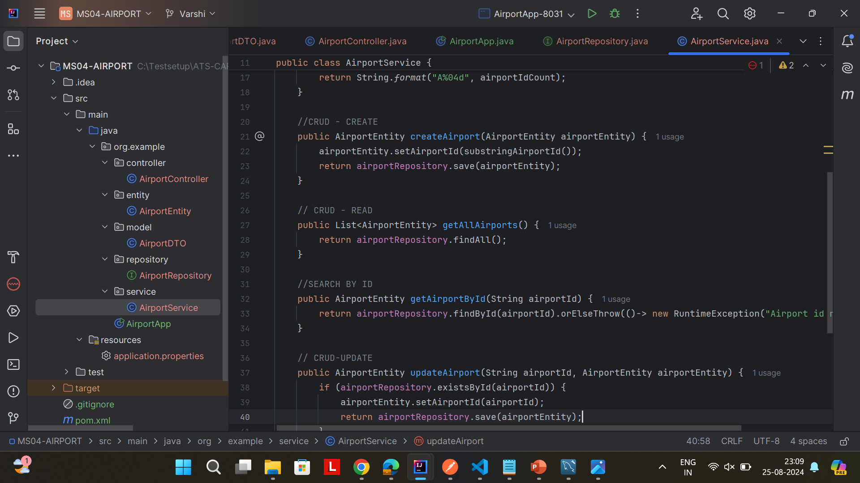
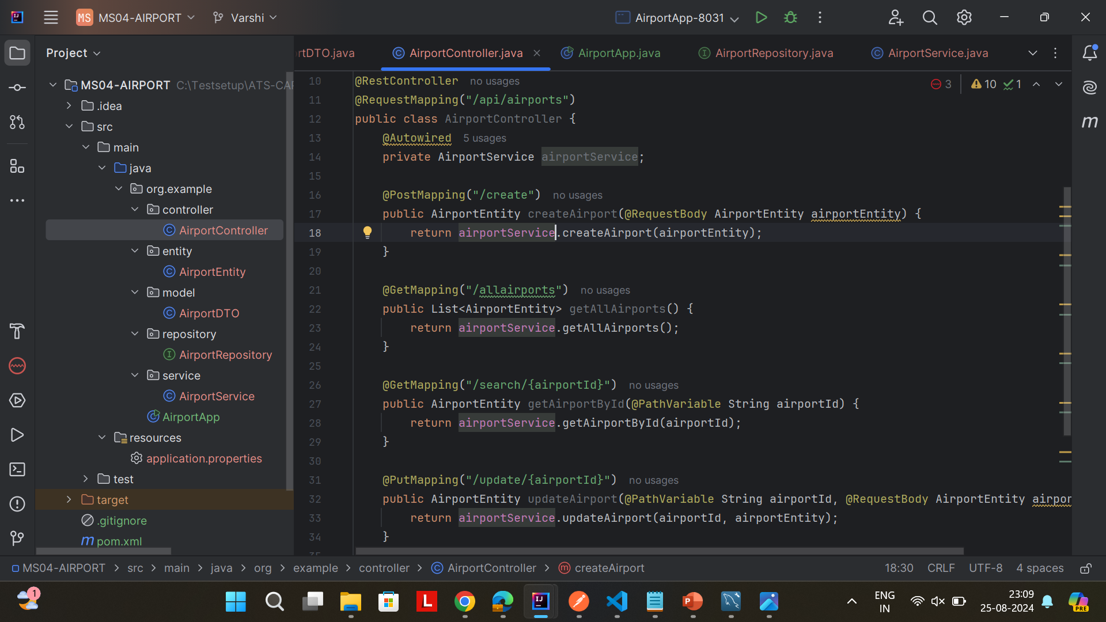
AIRPORT MICROSERVICES

Slide 14
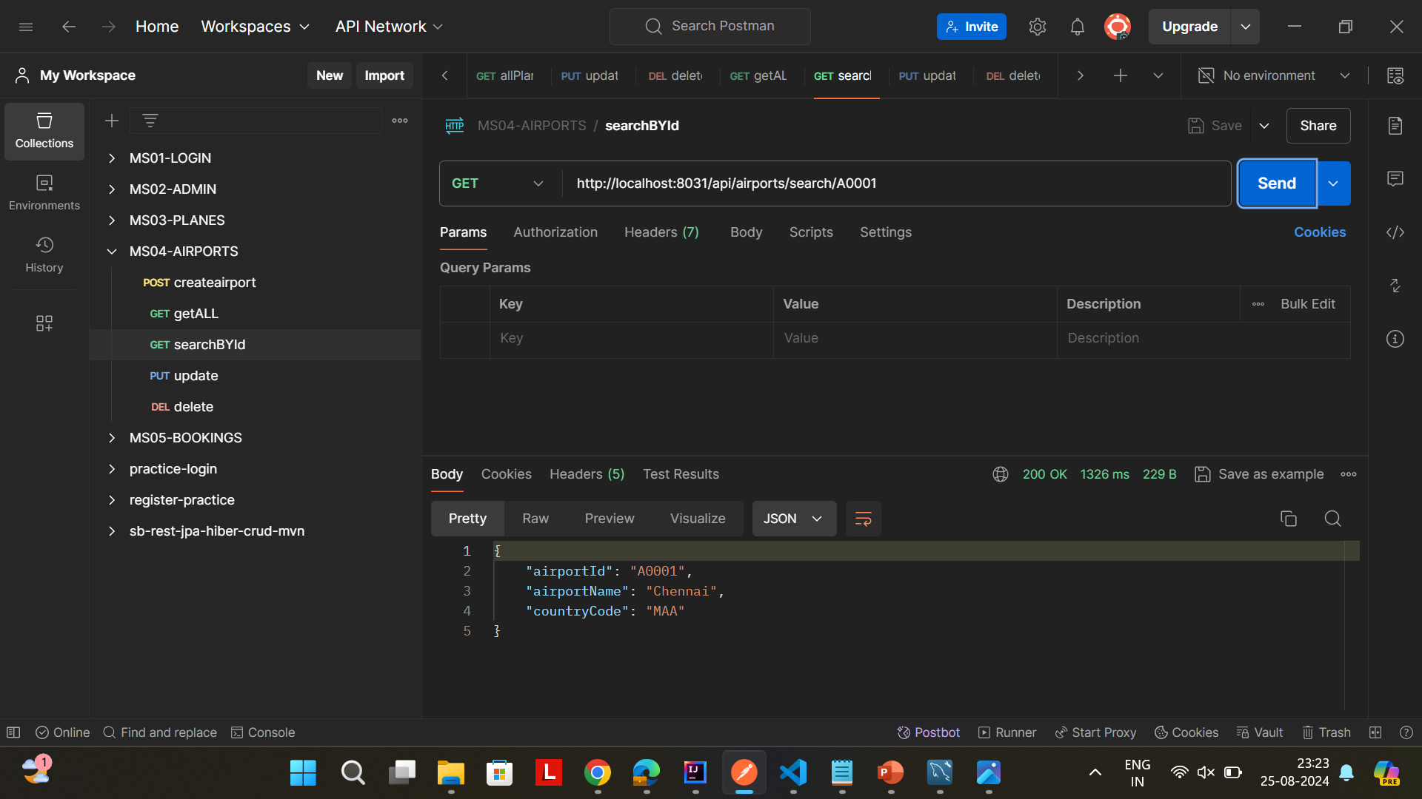
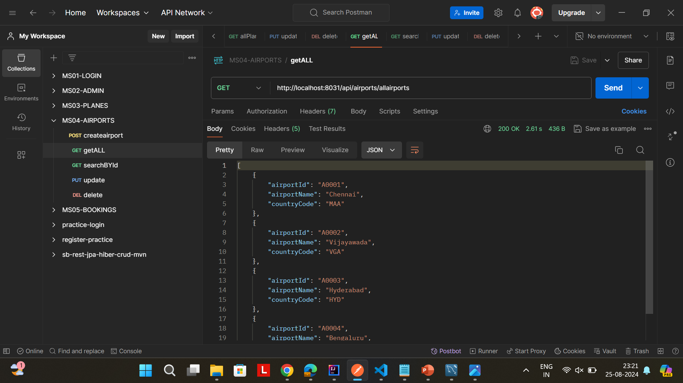
AIRPORT MICROSERVICES

Slide 15
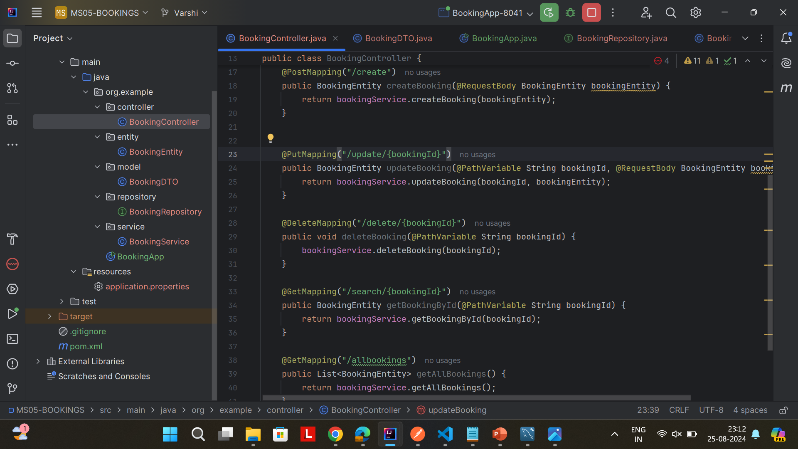
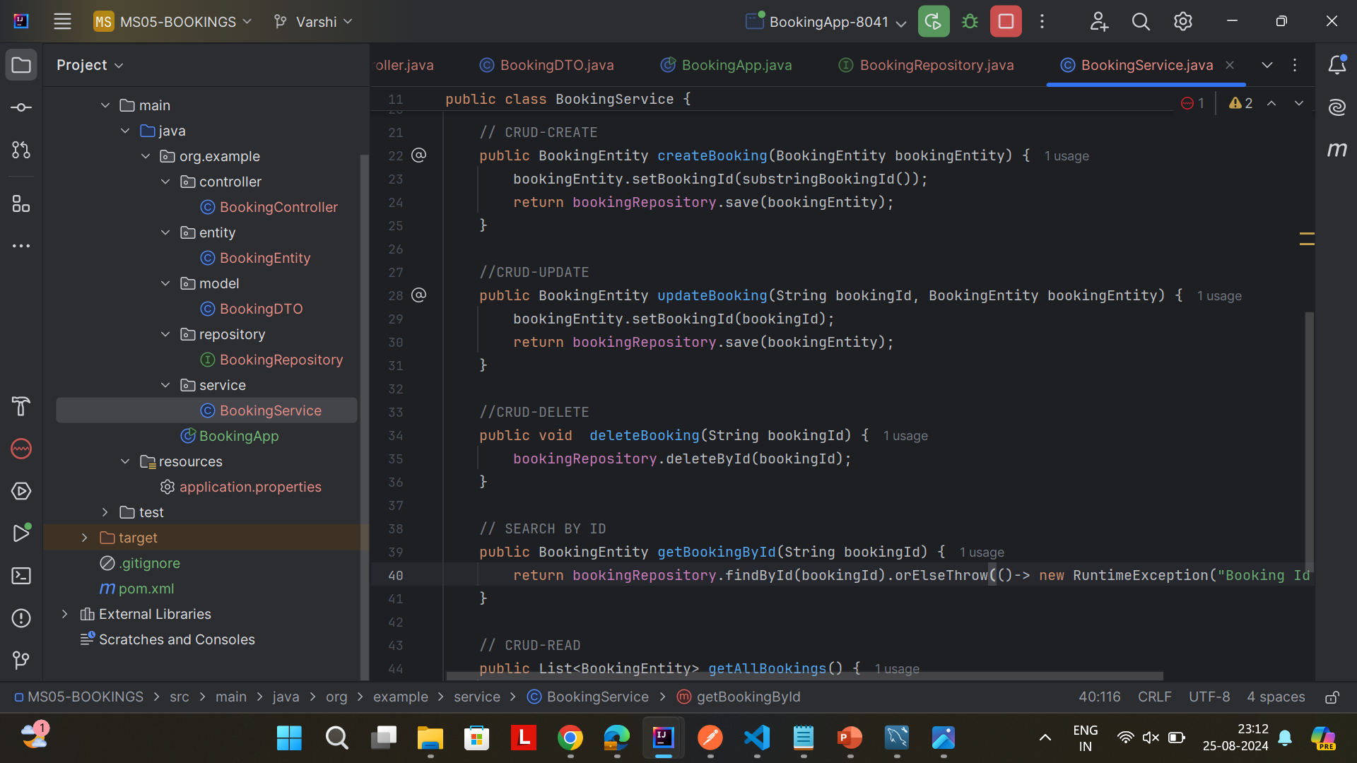
BOOKINGS MICROSERVICES

Slide 16
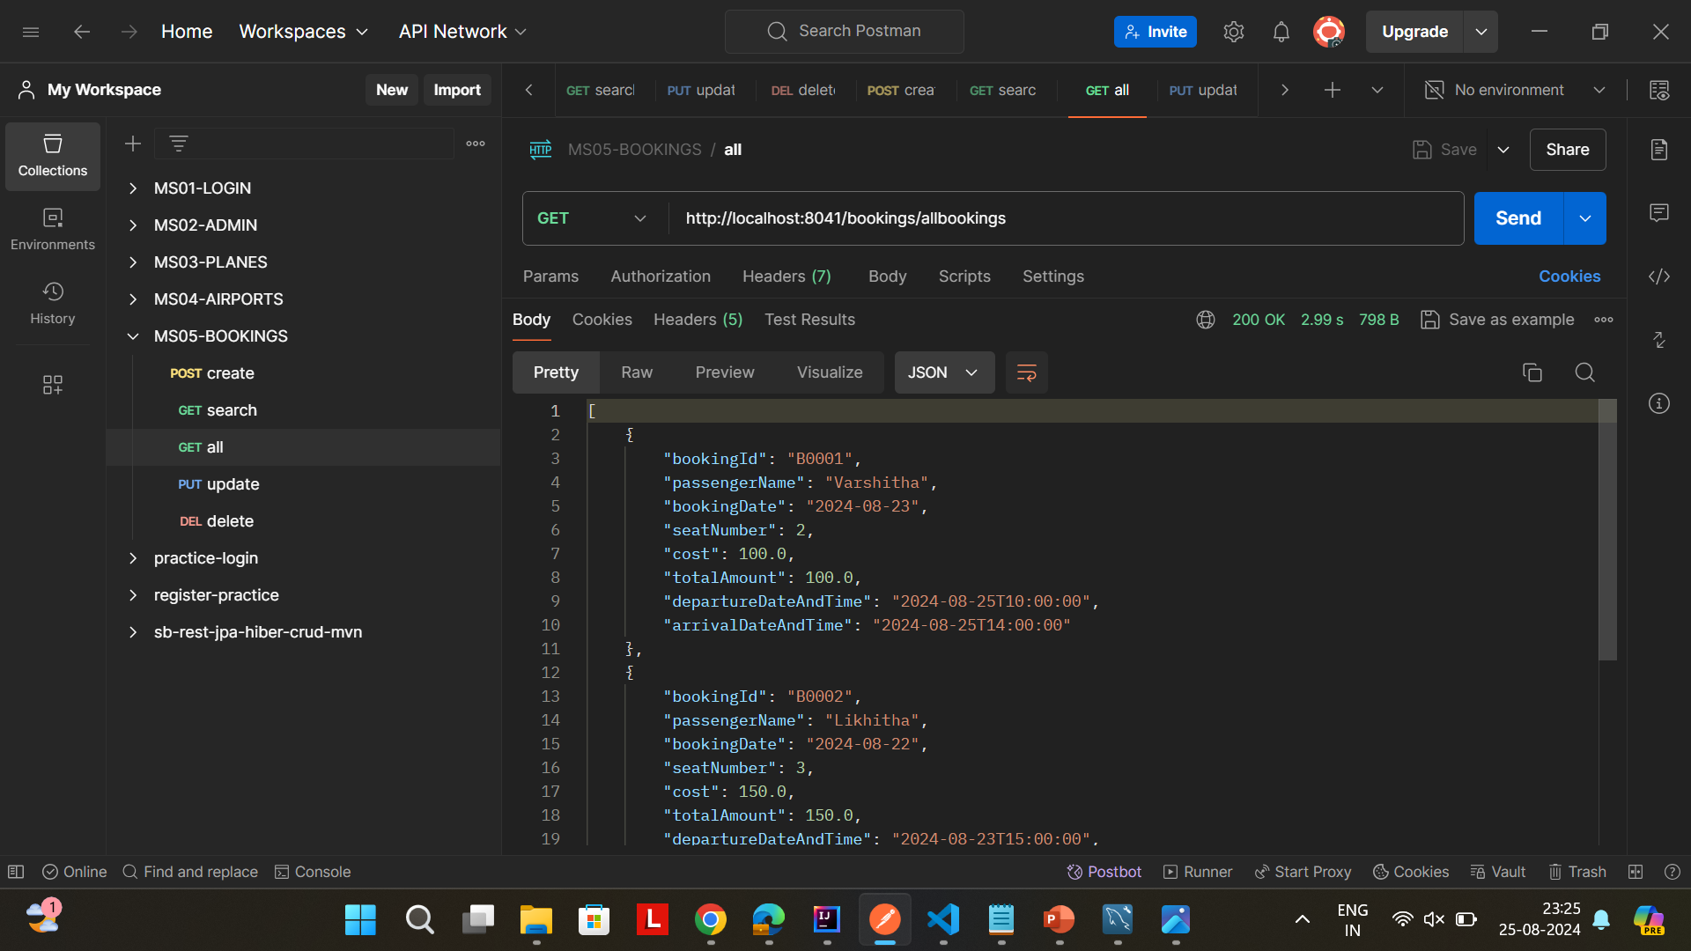
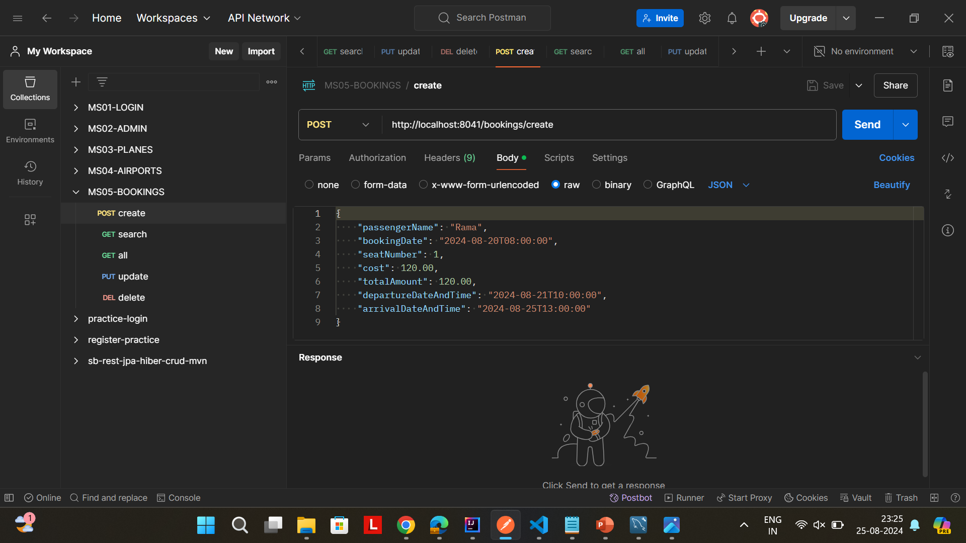
BOOKINGS MICROSERVICES

Slide 17
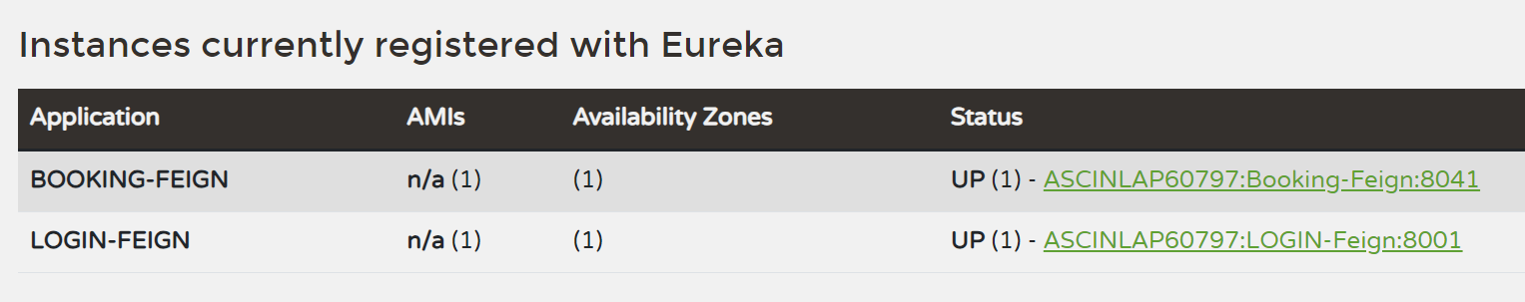
EUREKA SERVER

Slide 18
Conclusion
The Air Transport System delivers a backend solution for managing air transport operations, built using Spring Boot. It ensures efficient handling of key functionalities with complete CRUD operations for planes, airports, bookings, and user authentication. The Project demonstrates the effective use of Spring Boot, Hibernate, REST API, JPA, and Maven. The project encompasses various microservices including login, booking, plane, and airport services, each designed with specific functionalities and integrated seamlessly to create a robust system.

Slide 19
Thank You

